Slide 1
ALUMNI DATABASE
DATABASE PROJECT PRESENTATION

Slide 2
OBJECTIVES
Professional Development - Information about how to use the school to get a better job
Networking - alumni networking features, including ways to find out information about a classmate or other alumni, and the ability to view alumni contacts
Giving Back - A way to donate to the school and become engaged in a meaningful way
Connect and Evolve: Allow Alumni and students to connect through common interests via clubs

Slide 3

PROGRAMMING ENVIRONMENT
Front-end :
Angular
Back-end :
Spring
Database :
MySQL Workbench 8.0.18.CE
Dashboards :
Splunk with DBConnect

Slide 4
USER STORIES(Sprint 3 included)
US1-User can create an account and login
US2-Student can follow Alumni
US3-Clubs can create Events
US4- Alumni can follow other Alumni
US5-Alumni posts Job Postings
US6-Students views Job Postings and events
US7-Administrator creates clubs
US9-User searches Alumni company, industry, experience
US10-User searches Student by degree and stream
US8-Alumni joins clubs
US12-User Joins Events
US11-User can search for Alumni by year of graduation

Slide 5
HIGH LEVEL CONCEPTUAL DESIGN
Entities and Relationships are identified in High Level Conceptual Design
Entities:
Student
Alumni
Administrator
Events
Clubs
Job posting
Account
User

Slide 6
HIGH LEVEL CONCEPTUAL DESIGN
RELATIONSHIPS
User creates account
Users search for other users by qualifiers (degree, company…)
User follows User
Alumni creates job postings
Administrator creates clubs
User joins clubs
User Joins Event
Club creates Events
User views/searches events
Club Leader leads Club

Slide 7
CONCEPTUAL DESIGN
Conceptual Design with Entities and Relationships is represented using Entity - Relationship model.
Conceptual design modelled using Entity - Relationship model is Entity –Relationship Diagram.
Login and logout of account, searches and views are not stored in the database.

Slide 8
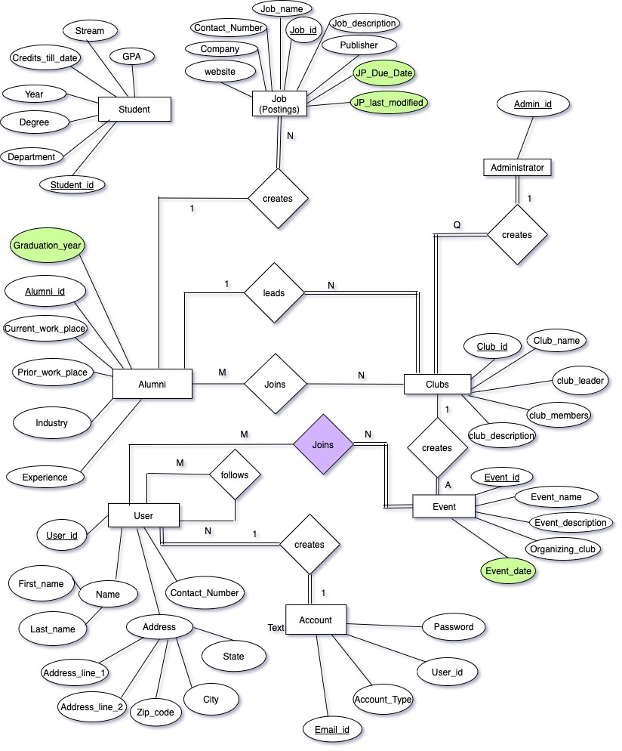
ENTITY RELATIONSHIP DIAGRAM

Slide 9
LOGICAL DESIGN (TABLES)
Account
Account Type
User
Alumni
Student
Administrator
Clubs
Job Postings
Event
Club Members
Follow
Participants

Slide 10
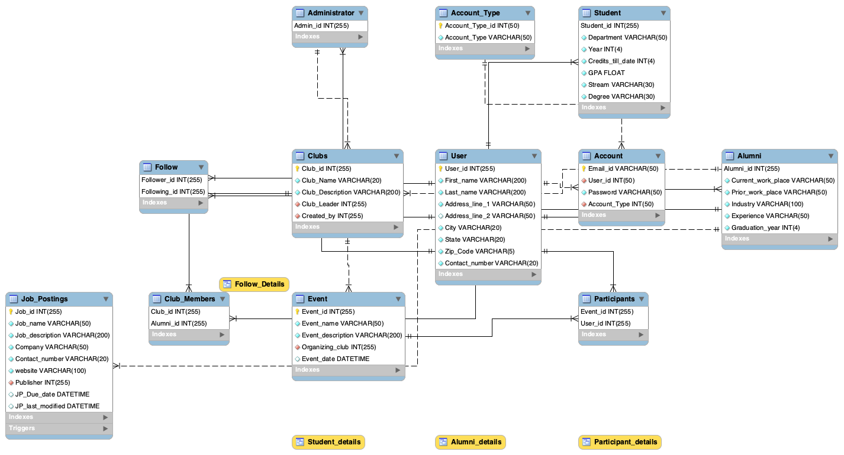
DATABASE SCHEMA

Slide 11
Indexes
Address on User - Address_line_1,Address_line_2,City,State,Zip_code
Graduation_year_indx ON Alumni - Graduation_year
Work_Place ON Alumni - Current_work_place, Prior_work_place
Academic_info ON Student - Stream,Degree
Job_info ON Job_Postings - Job_description, Company
Event_info ON Event - Event_name, Organizing_Club

Slide 12
VIEWS
Alumni Details- View showing Alumni Details
Student Details- View showing Student Details
Follow Details – View showing user following other User
Participant Details – View with details of users participating in an event

Slide 13
SQL QUERY - VIEWS
Query to create PARTICIPANT DETAILS view
Create View Participant_details as SELECT
Event_name, CONCAT_WS(' ',First_name, Last_name) AS Participant, Email_id as Participant_email FROM User
INNER JOIN Participants USING(User_id)
INNER JOIN Event USING(Event_id)
INNER JOIN Account USING(User_id);

Slide 14
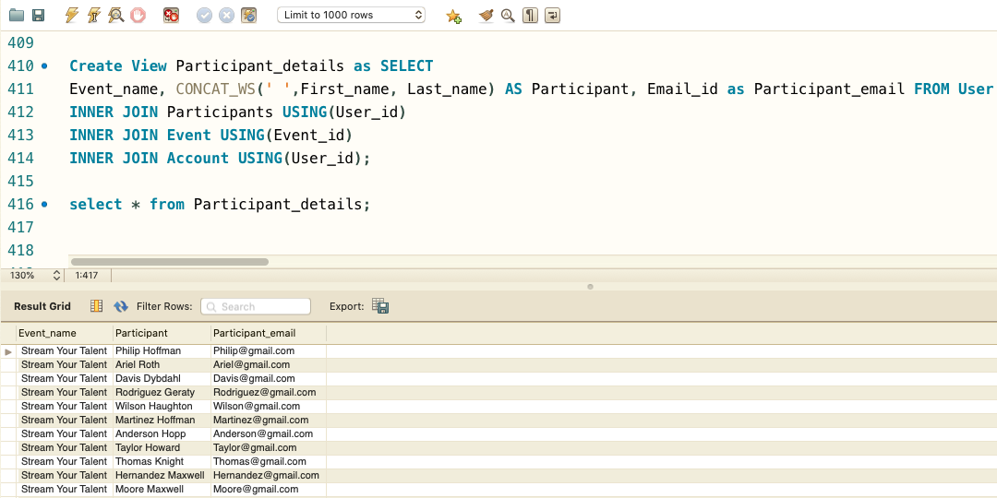
OUTPUT

Slide 15
STORED PROCEDURE
Stored procedure named Job_due_date_update is created
To update Job Posting Due date in the Job postings Table
Query:
DELIMITER $$
CREATE PROCEDURE Job_due_date_update( IN Due_date Datetime , IN J_id int(255))
BEGIN
UPDATE Job_Postings SET
JP_Due_date = Due_date WHERE Job_id = J_id;
END $$
DELIMITER ;
CALL Job_due_date_update('2019-08-03',2);
CALL Job_due_date_update('2020-10-02',3);
SELECT * from Job_Postings;

Slide 16
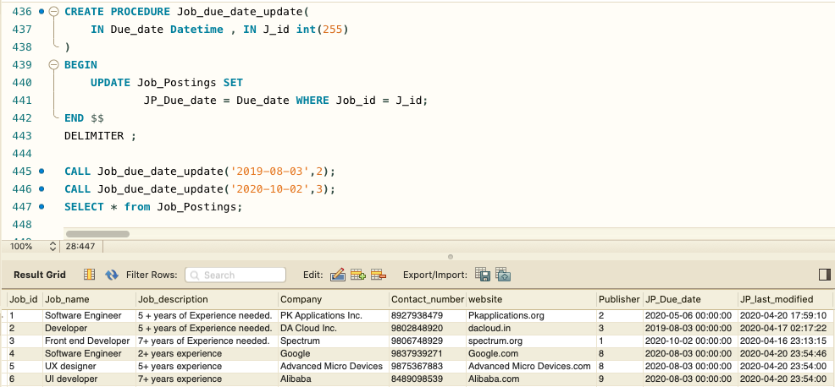
OUTPUT

Slide 17
TRIGGERS
Triggers Job_posting_insert and Job_posting_update are created
To update the modified date in Job Postings Table with every insert and update on Job Postings Table
Query:
CREATE TRIGGER Job_posting_update
BEFORE UPDATE ON Job_Postings
FOR EACH ROW
SET new.JP_last_modified =current_timestamp();
CREATE TRIGGER Job_posting_insert
BEFORE INSERT ON Job_Postings
FOR EACH ROW
SET new.JP_last_modified =now();
SHOW TRIGGERS;

Slide 18
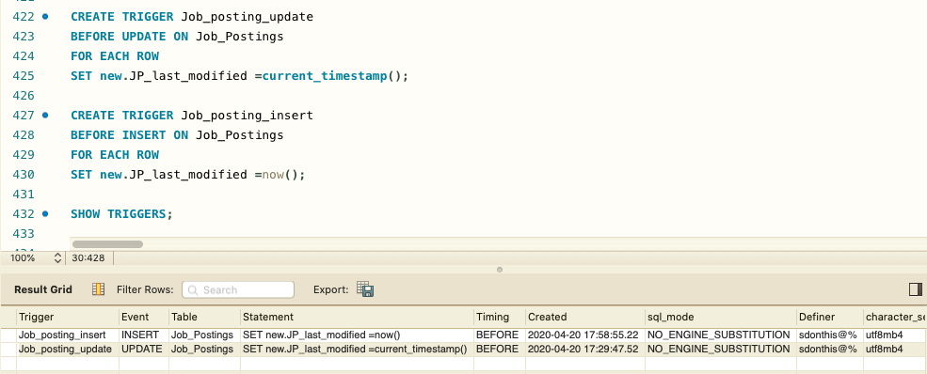
OUTPUT

Slide 19
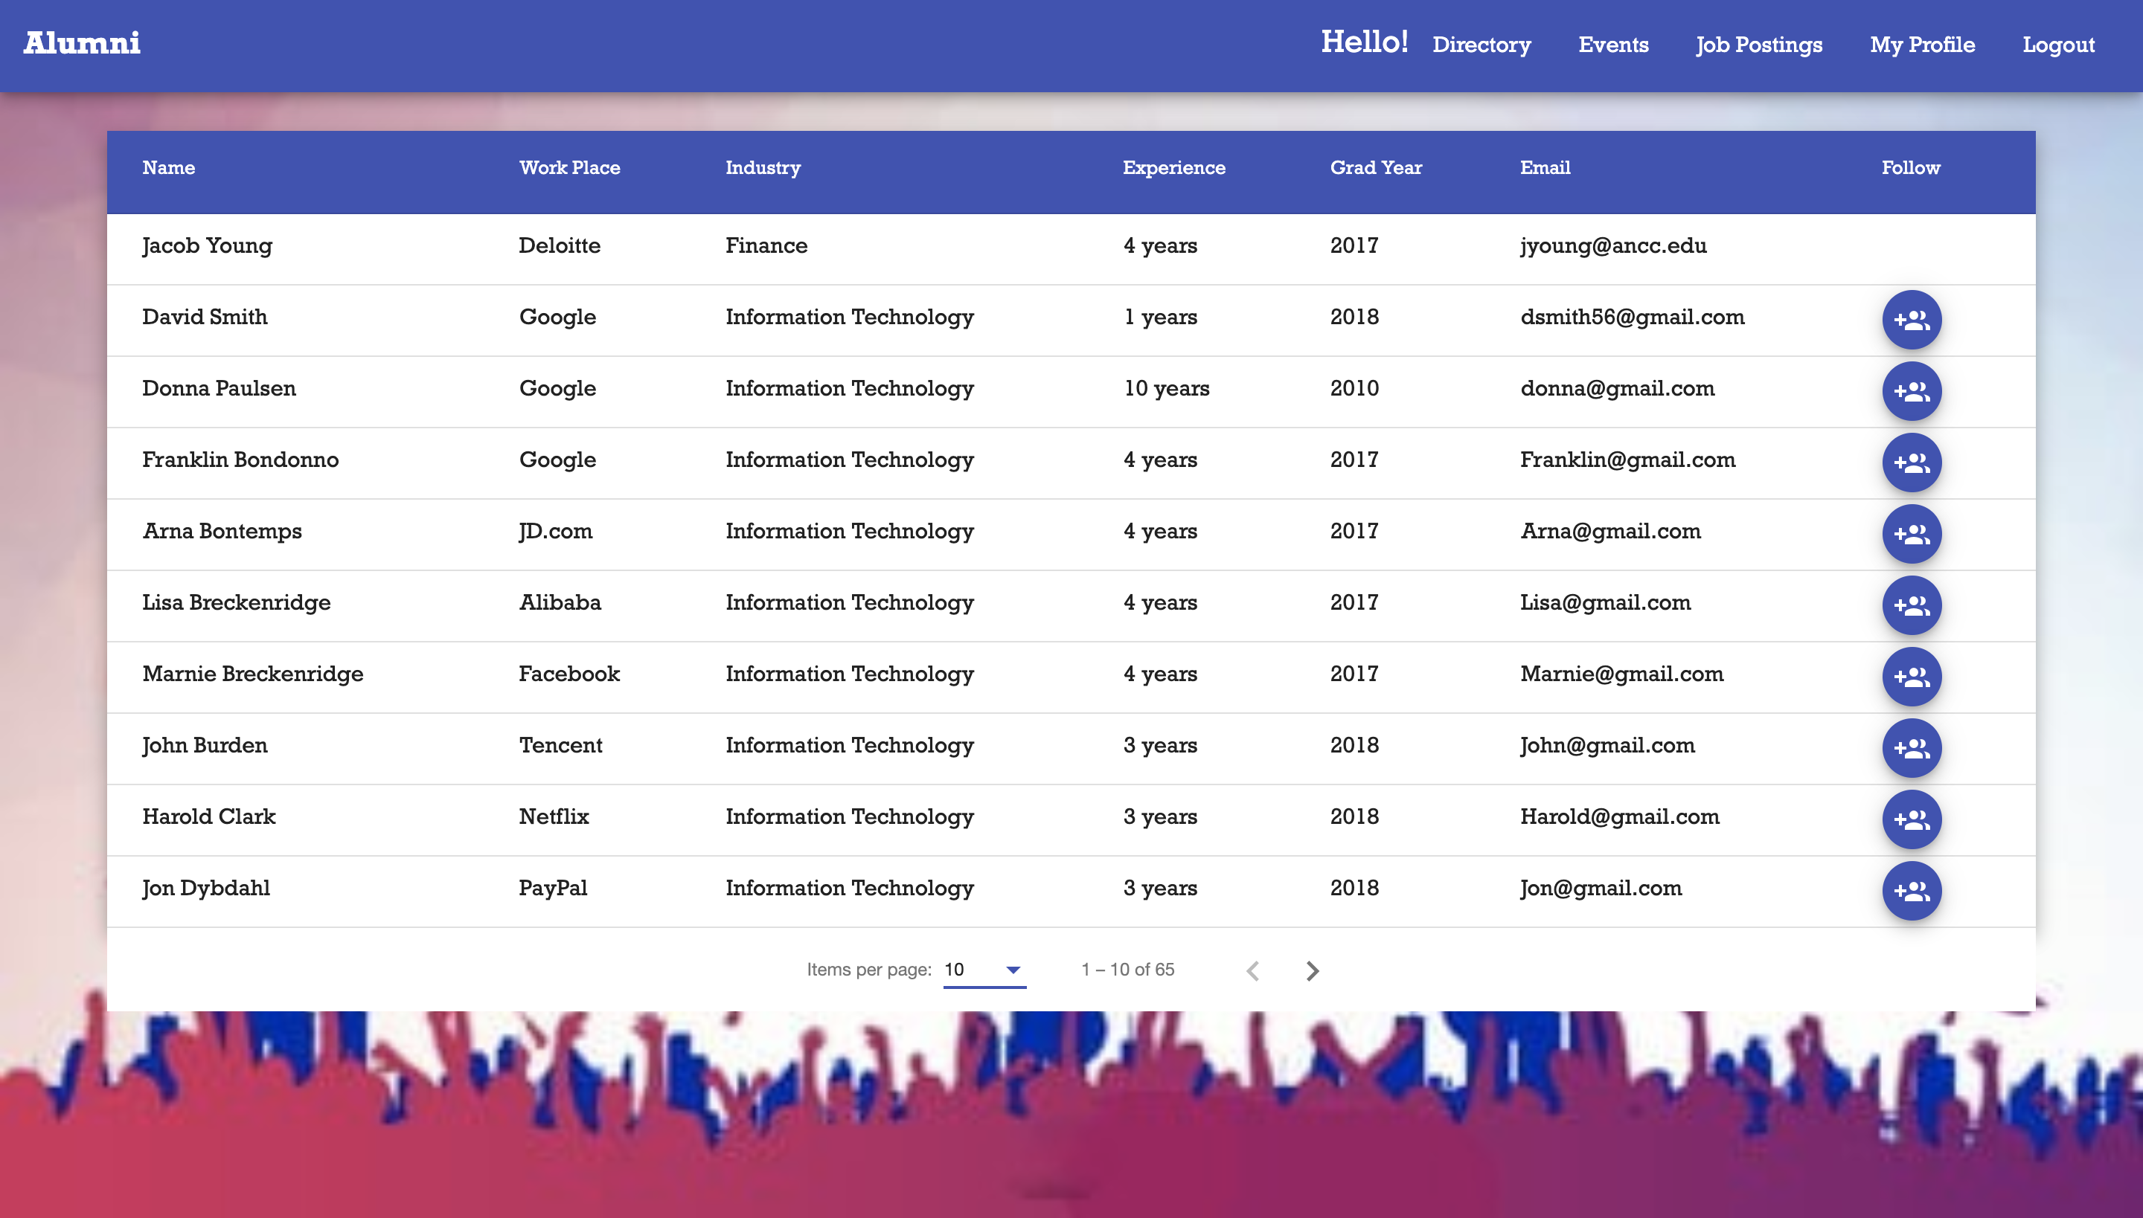
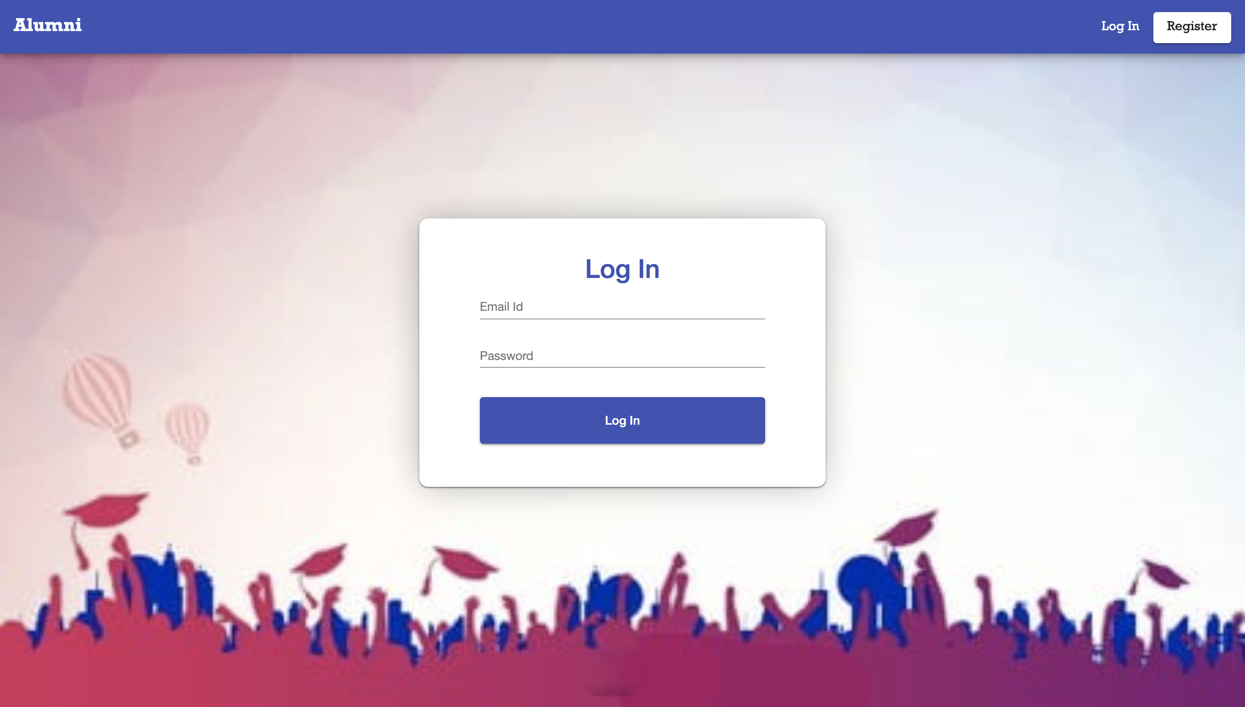
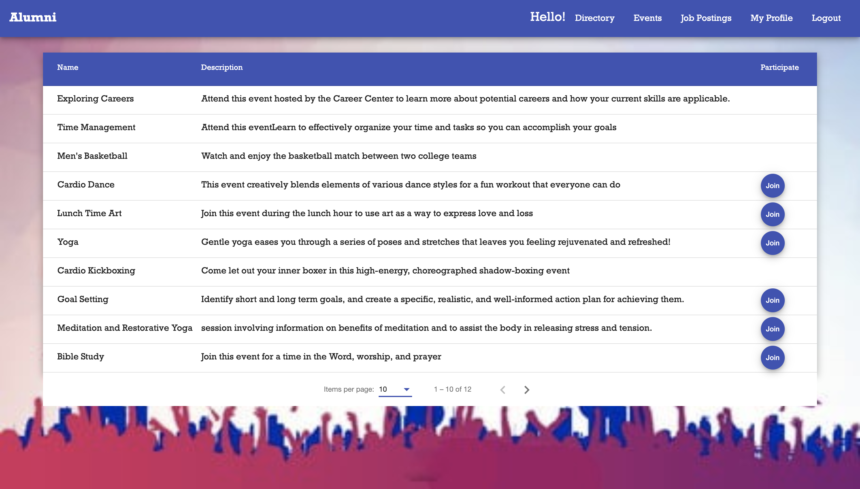
USER INTERFACE

Slide 20
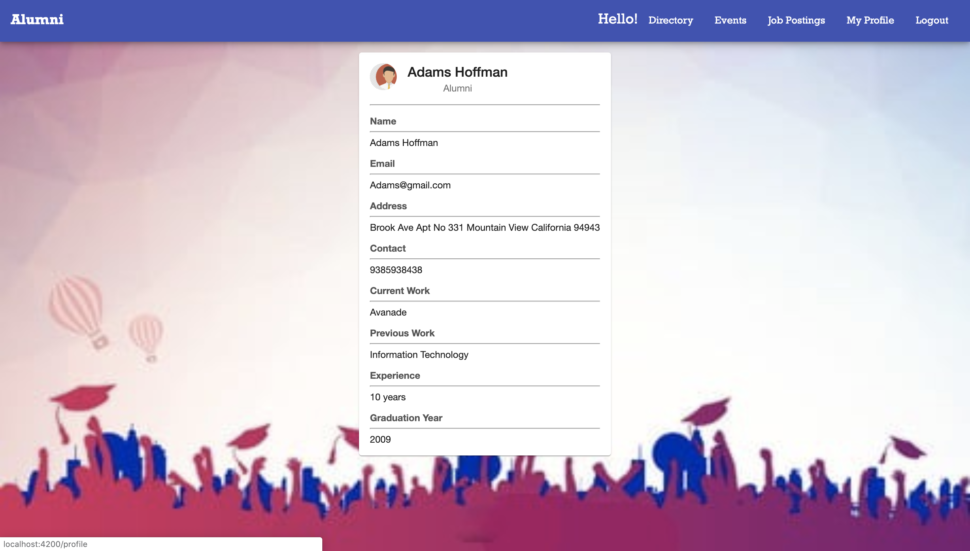
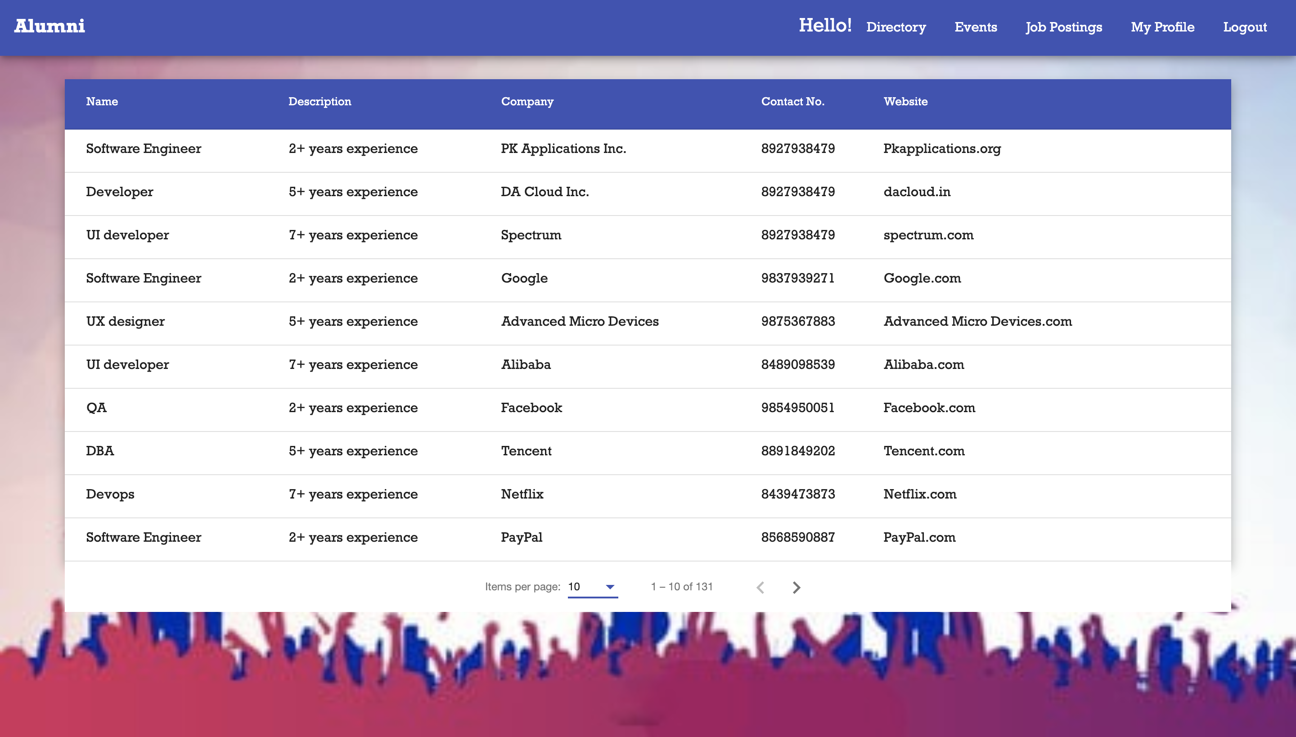
USER INTERFACE

Slide 21
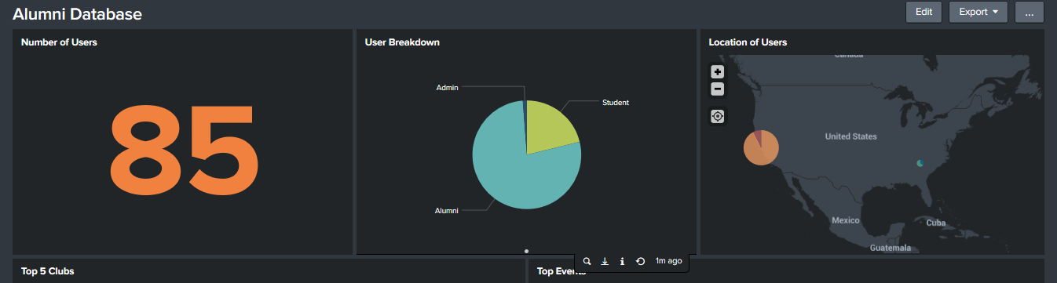
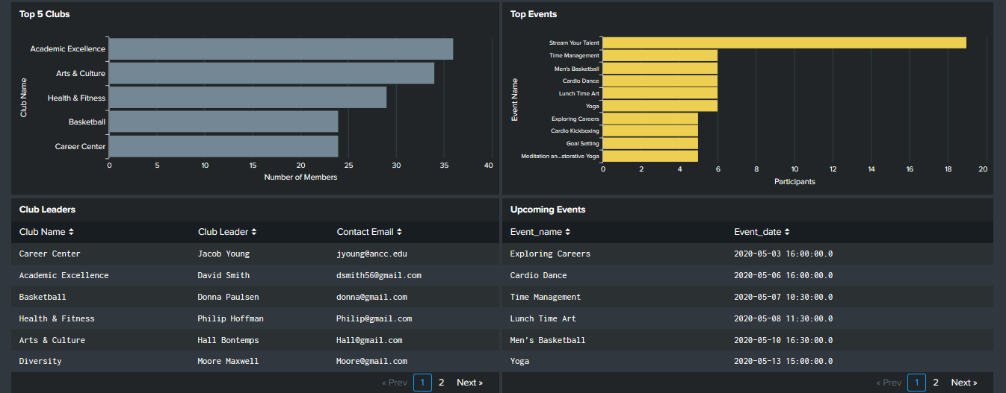
SPLUNK DASHBOARD

Slide 22
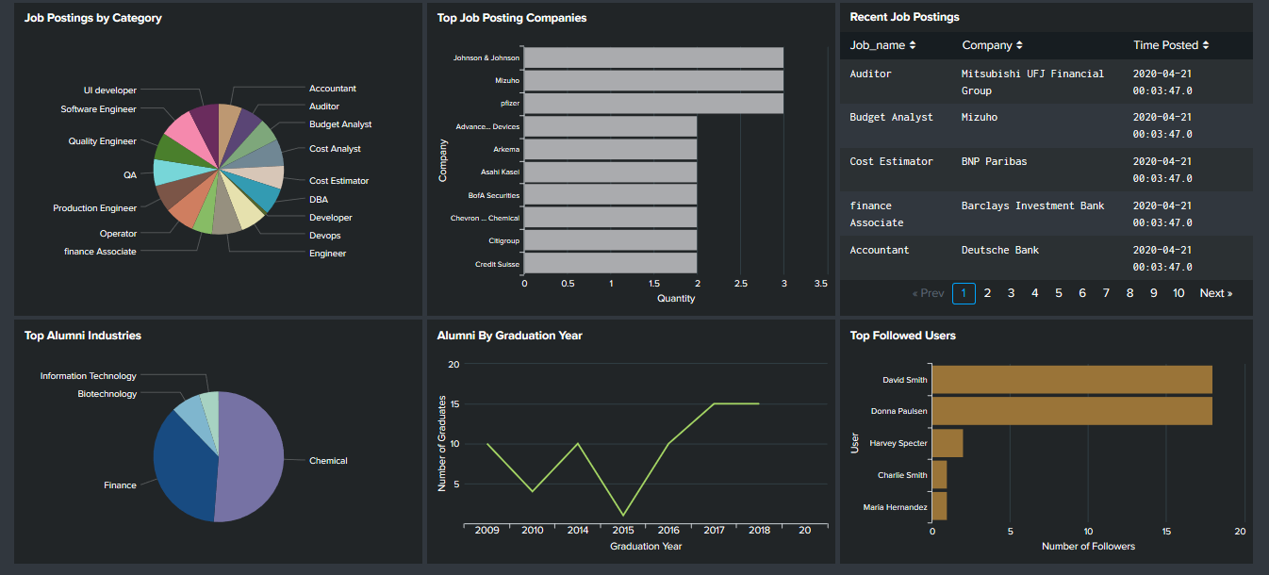

Slide 23
TEAM MEMBERS
Naman Manocha
Dion Chapel
Shravya Donthisaram
Mahalavanya Sriram

